Slide 1


VIRTUOSO'2020
Prospect and Introspect the Technological world.

Slide 2
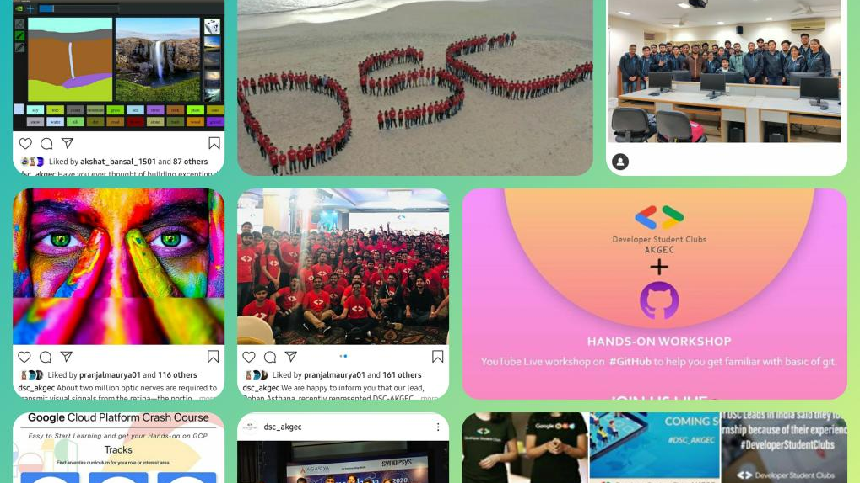
DEVELOPER SUDENTS CLUB, AKGEC

Slide 3
Content
Aim of the Event
About DSC
Activities
Some common queries
Conclusion

Slide 4
Aim
Every year, more than 400 students participate in the recruitment drive of DSC, AKGEC.
Most of them lack complete knowledge of what Developer Students Club actually does.
The main aim of this event will be, to take all the students to a complete tour of our society by means of fun and knowledgeable activities.

Slide 5

Fun Activities
Participants will be participating in different fun activities.
Prizes
Introduction
The top three performers in each session will be awarded with goodies.
To DSC, community that fosters the spirit of learning and a student focused development program by Google developers.

Slide 6
Activities
App development : Build Your Own App
Web Development : Create Your First Webpage
Machine Learning : Face Recognition
Management : Draw your dreams into reality

Slide 7
Procedure
There will be total four sessions of duration one hour each in which four different activities will be conducted.
Firstly, a Google meet will be conducted in which our team will give a brief introduction of all four domains (App development, Machine Learning, Web development and Management ) to all the participants .
After the introduction, we’ll let the participants decide the activity they want to participate in, first.
All the participants will be divided in groups on the basis of their choice of activity.

Slide 8
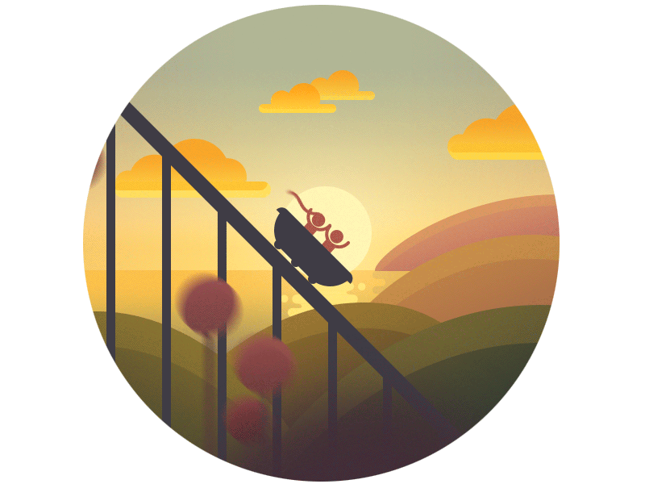
Date and Time
* Virtuoso’2020 will be a one day event with a duration of 2 to 4 hours.
* If the participation exceeds the limit, days can be extended.
* After the Introductory meet, participants will be provided links to join the respective meeting based on their choice of Activity.

Slide 9
Introductory Meet
Duration : 30 – 35 minutes
Platform : Google Meet
Maximum no. of participants : 50 - 60

Slide 10
Introduction to DSC
A community of Google Developers.

Slide 11
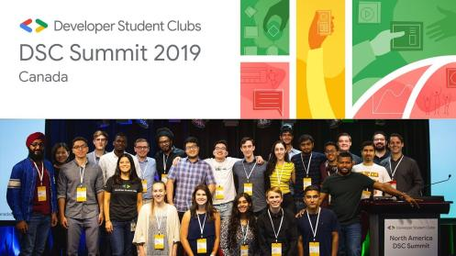
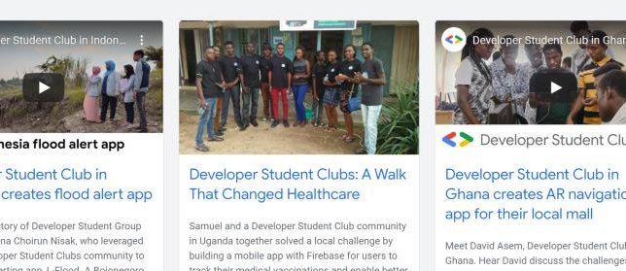
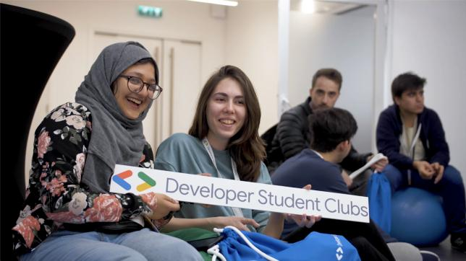
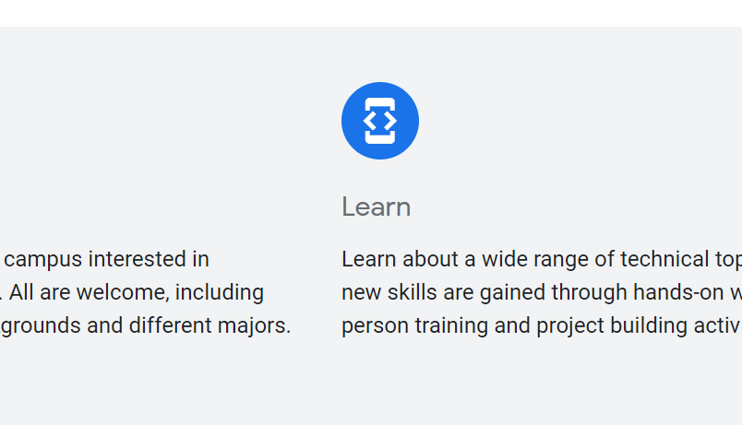

Slide 12



Connect
Learn
Grow
Meet other students on campus interested in developer technologies.
Learn about a wide range of technical topics where new skills are gained through hands-on workshops, in-person training and project building activities.
Apply your new learnings and connections to build great solutions for local problems. Advance your skills, career and network.

Slide 13
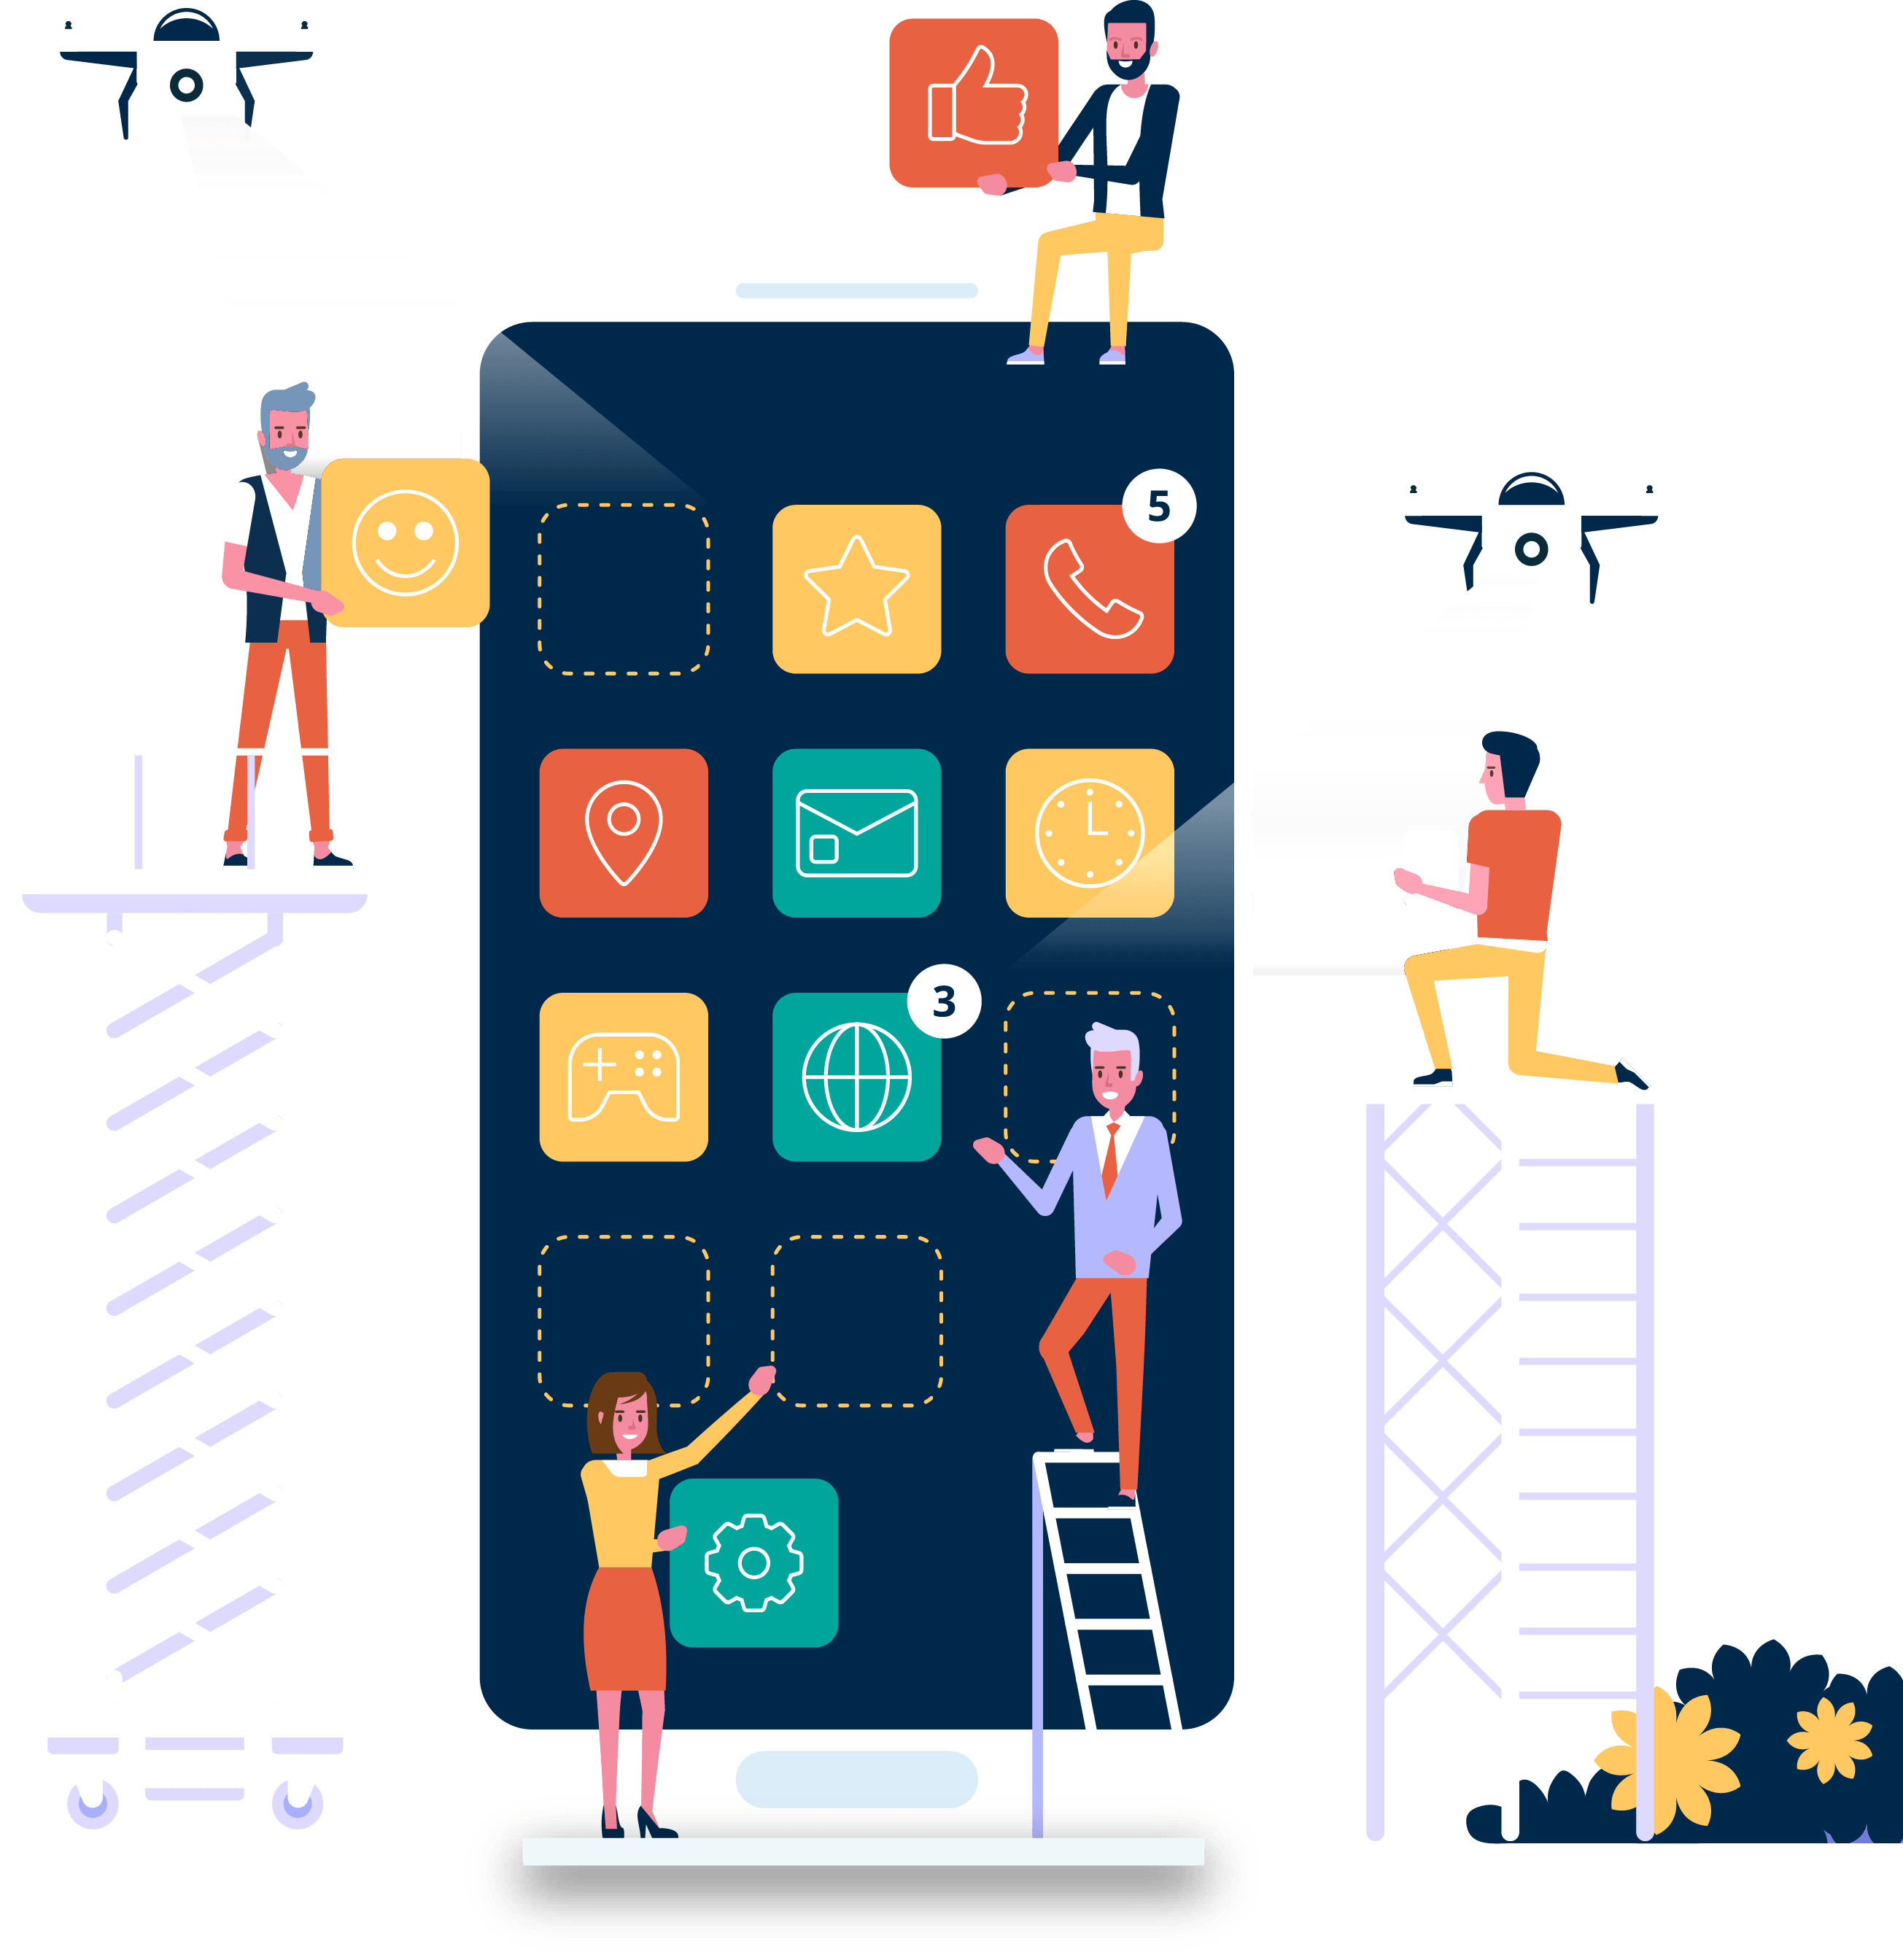
App Development

Slide 14




WEB DEVELOPMENT

Slide 15



Slide 16


Management

Slide 17
Session -1
Duration : 30 – 35 minutes
Domain : App development
Platform : Google Meet
Maximum no. of participants : 15 - 20

Slide 18
Build your own first application in just 5 minutes!
1. Our team will be giving a demo on how to build a application to the participants.
2. The platform which can be used for this activity is go canvas.
3. Participants have to follow four simple steps (about which we can inform them through mail, a day prior to the event) -
Step 1 – signup for Go Canvas
Step 2 – Install Go Canvas
Step 3 – Login to Go Canvas website using laptop/desktop
Step 4- Build your first application

Slide 19
Session -2
Duration : 30 – 35 minutes
Domain : Web Development
Platform : Google Meet
Maximum no. of participants : 15 - 20

Slide 20
Build your first web page with us!
1. A mail will be sent before the event regarding instructions to signup on the platform where participants will be making the website.
2. Our team will be guiding participants to write the HTML, CSS and JS code to create their own websites
3. At last, there will be a small a small exhibition in which all the participants will be asked to present their screens to show their websites.
4. Sublime Text 3 can be preinstalled by the participants before the event to write their HTML, CSS and JS code.

Slide 21
Session -3
Duration : 30 - 35 minutes
Domain : Machine Learning
Platform : Google Meet
Maximum no. of participants : 15 - 20

Slide 22
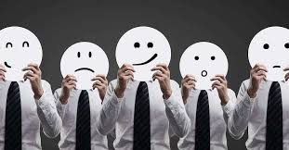
Face Recognition
1. Participants will be provided with the face recognition software made by our team.
2. They will be asked to open it on their respective screens and input their current mood facing the camera.
3. The computer will detect their mood through facial expressions.

Slide 23
Session -4
Duration : 40 – 50 minutes
Domain : Management
Platform : Google Meet
Maximum no. of participants : 15 - 20

Slide 24
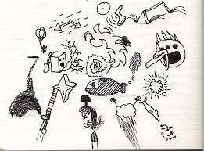
Draw your dreams into reality.
Inspired by Patti Dobrowolski

Slide 25


How to perform.
Draw your dreams into reality
1. A participant will be asked to take a pen and paper and draw what he wants to become in the future on that paper
2. Now, a volunteer will be asked to predict the person's goals and thoughts from the image the participant has drawn

Slide 26
How to perform.
In this way, through team work, participants will learn the value of management and co-ordination.
And, this interactive activity will make the environment warm and friendly among all.

Slide 27






Some Common Queries
Why DSC
Skills Required
Opportunities
Recruitment
Social Media Handles
Achievements

Slide 28
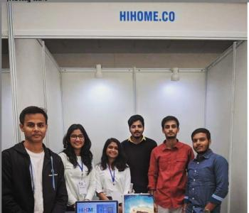
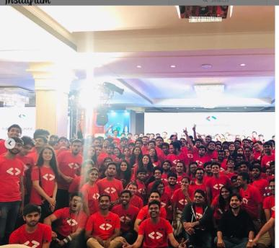
At the end of each session, Participants will be asked to fill a feedback form and will be introduced to our team.
Lets connect, learn, and grow together!

Slide 29
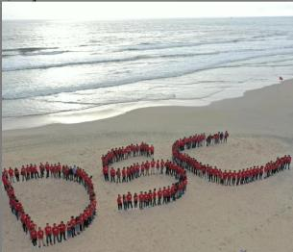
Thanks!
Connect with us:
Instagram: @dsc_akgec
Facebook: @dscAKGEC
LinkedIn: Developer Students Club AKGEC

